Slide 1
PRINTMAKING
ABSTRACTION & PATTERN

Slide 3
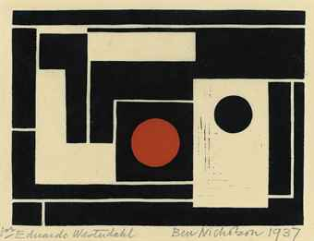

Slide 5
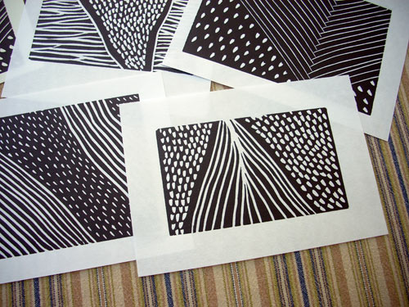

Slide 6
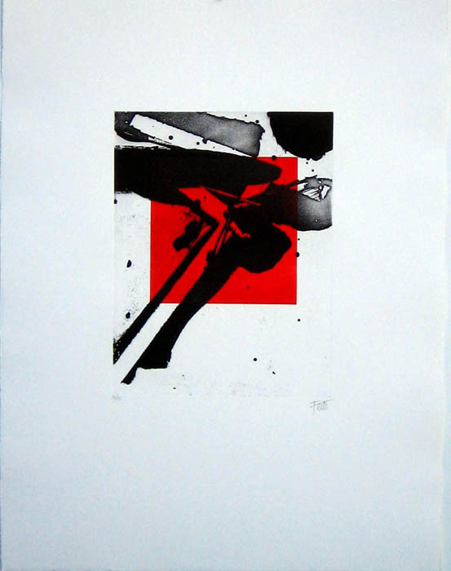

Slide 8
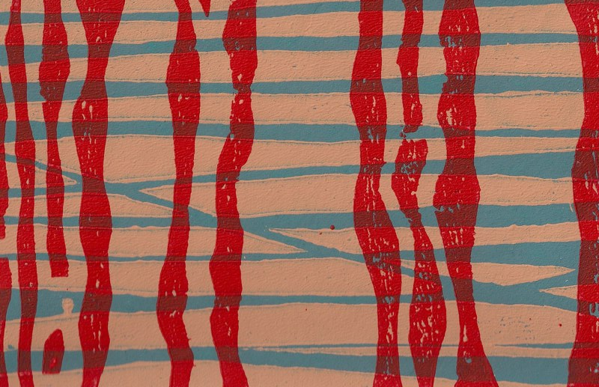

Slide 9
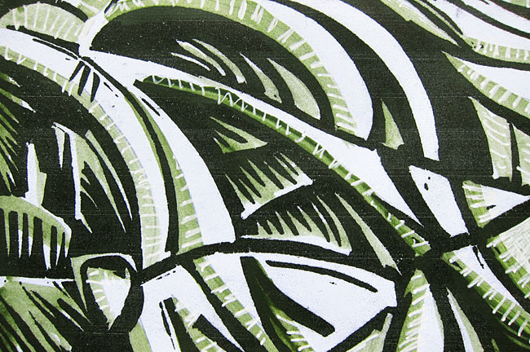

Slide 10
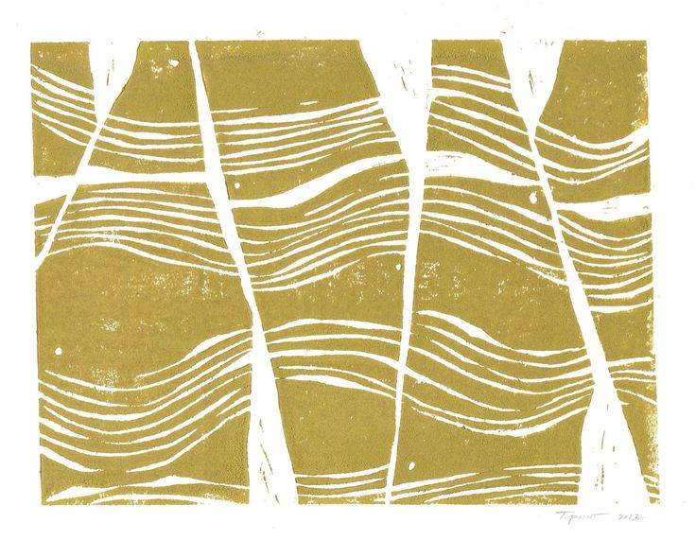

Slide 11
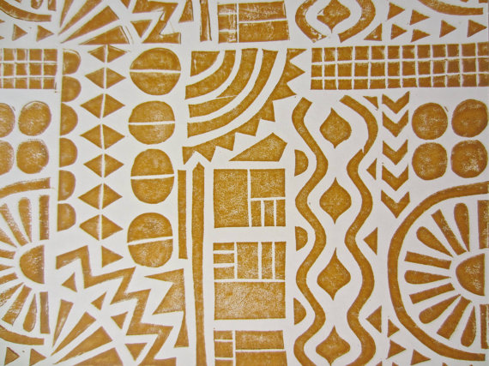

Slide 13
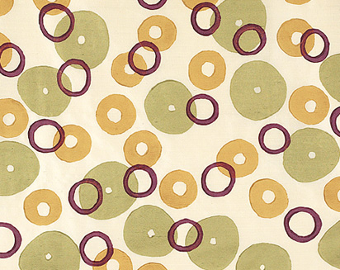

Slide 14
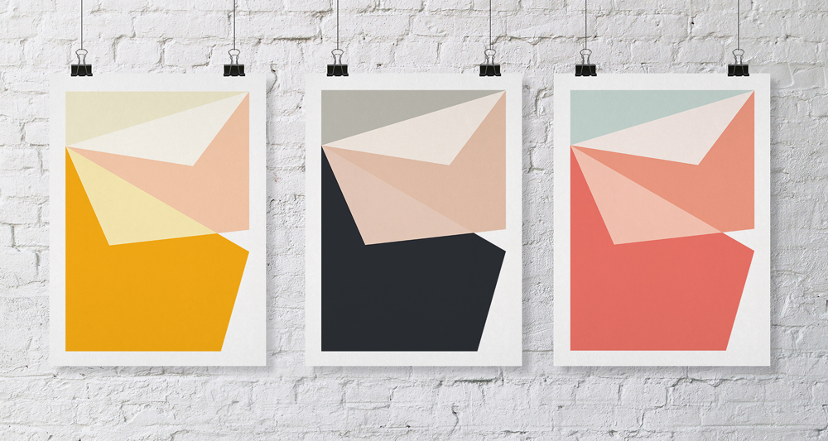

Slide 16
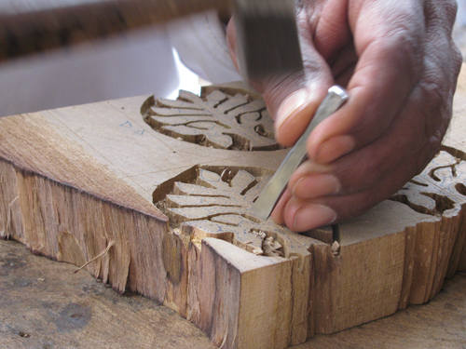

Slide 17
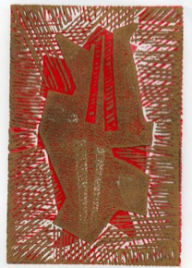
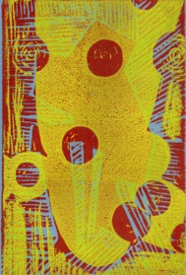
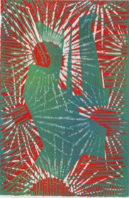
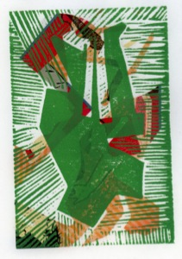
YOU WILL PRODUCE FOUR PRINTS.

Slide 18
SELECT THREE PIECES OF PAPER TO PRINT ON

Slide 19
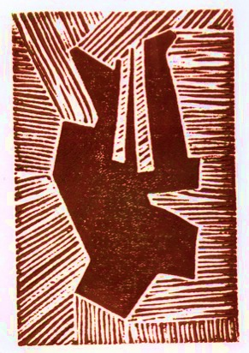
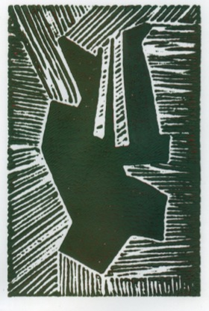
PRINT ONE PRINT TWO PRINT THREE

Slide 20
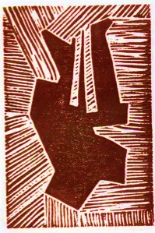
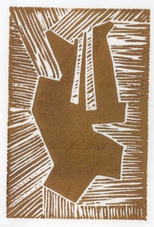
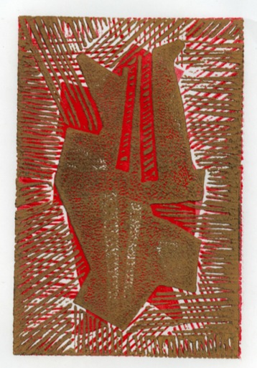
PRINT ONE
+
SAME PLATE IN REVERSE

Slide 21
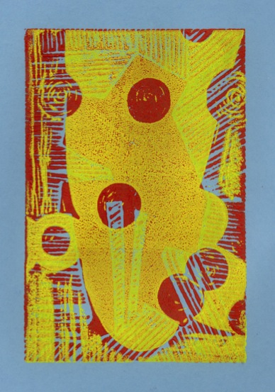
PRINT TWO
+
SOMEONE ELSE’S PLATE ON TOP

Slide 22
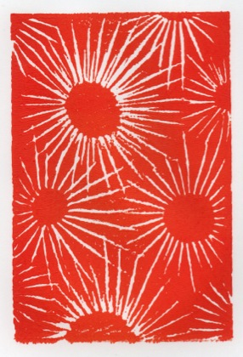
GIVE YOUR THIRD PRINT TO SOMEONE
GET SOMEONE ELSE’S THIRD PRINT

Slide 23
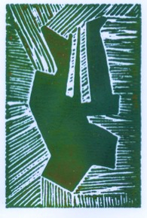
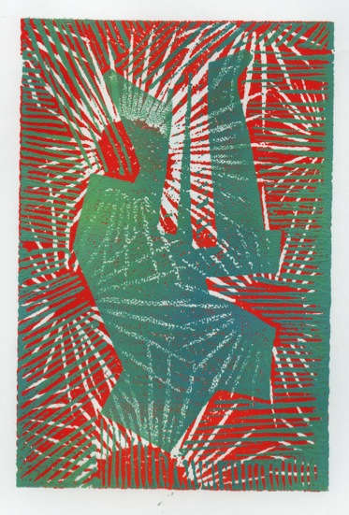
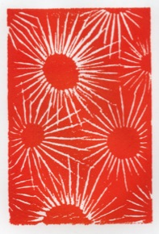
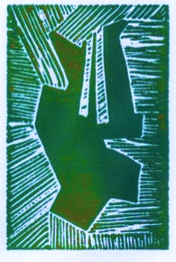
SOMEONE ELSE’S THIRD PRINT
PRINT YOUR PLATE ON TOP
+

Slide 24
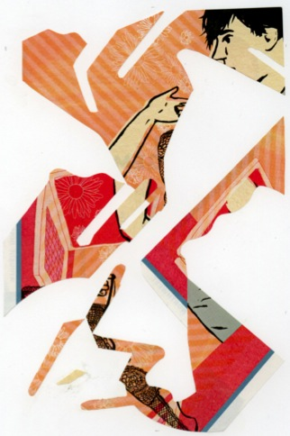
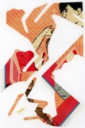
GET A FOURTH PIECE OF PAPER
MAKE A COLLAGE THE SIZE OF A PRINT

Slide 25
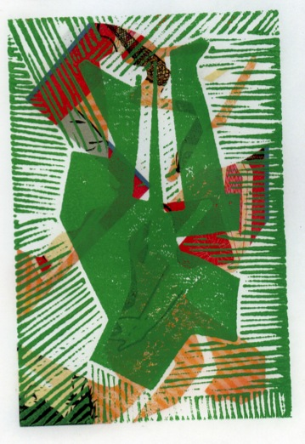
YOUR COLLAGE + YOUR PRINT

Slide 26
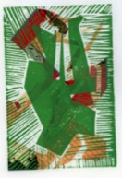
IF ANY OF YOUR BORDERS ARE MESSY OR YOUR PRINT IS ASKEW
MOUNT THE PRINTS ON CLEAN WHITE PAPER

Slide 27
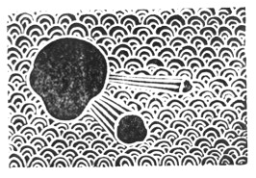
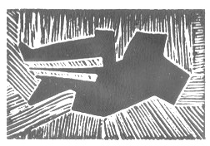
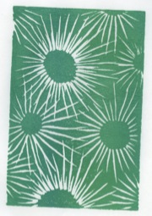
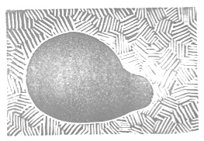
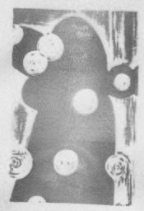
YOUR PLATE DESIGN SHOULD HAVE
AN ASYMMETRIC COMPOSITION
A PATTERN
AT LEAST 50% OF THE SPACE MARKED
*
*
*

Slide 28
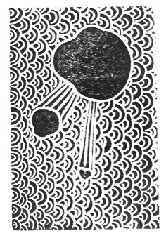
THE IMAGE YOU DRAW ON YOUR PLATE WILL PRINT IN REVERSE

Slide 29
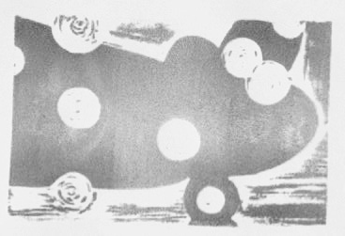
THE AREA YOU DRAW ON YOUR PLATE WILL NOT PRINT
THE AREA YOU LEAVE BLANK WILL PRINT

Slide 30
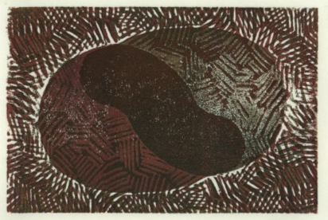
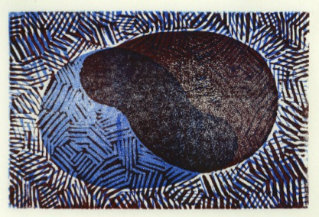
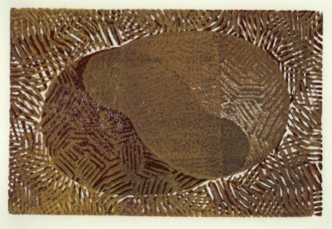
THE COLOR OF EACH PRINT AND THE ORDER OF THE COLORS WILL HAVE A BIG IMPACT

Slide 31
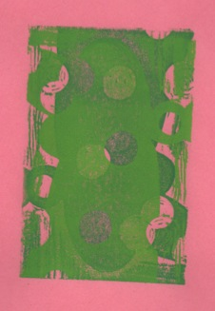
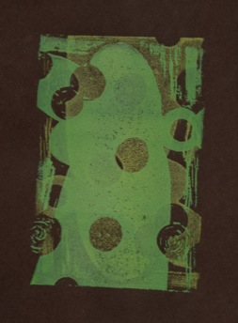
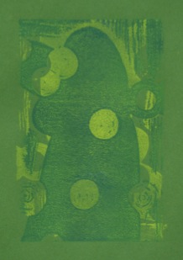
THE COLOR OF YOUR PAPER AND THE AMOUNT OF CONTRAST BETWEEN PRINT COLORS MAKE A BIG DIFFERENCE

Slide 32
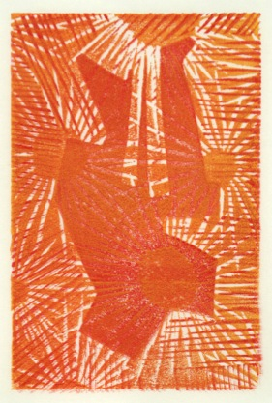
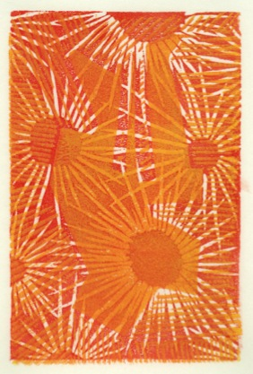
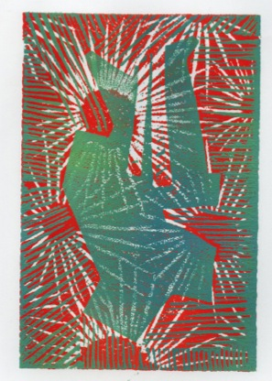
THE FIRST PRINT (UNDERNEATH) IS RED-ORANGE IN ALL THREE PRINTS

Slide 33
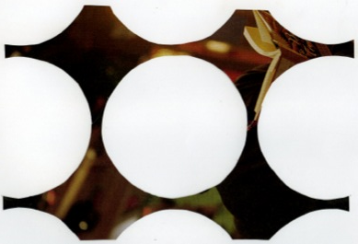
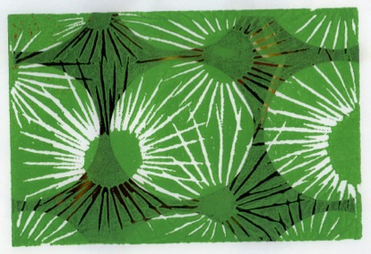
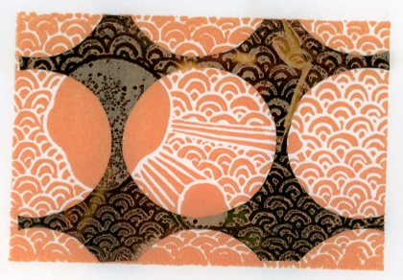
THE COLOR OF THE PRINT AND THE VALUE OF THE COLLAGE WILL ALTER WHETHER THE PRINT OR THE COLLAGE IS MORE DOMINANT

Slide 34
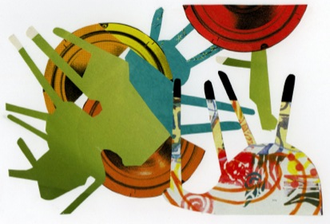
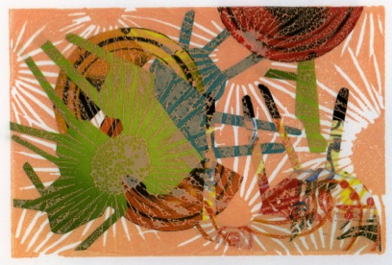
YOUR COLLAGE DESIGN MAY WORK WELL WITH YOUR PLATE BUT WOULD NOT WORK FOR SOMEONE ELSE

Slide 35
YOUR PLATE DESIGN SHOULD HAVE
AN ASYMMETRIC COMPOSITION
A PATTERN
AT LEAST 50% OF THE SPACE MARKED
*
*
*

Slide 38
THERE IS A DIFFERENCE BETWEEN AN ASYMMETRIC SHAPE AND AN ASYMMETRIC COMPOSITION

Slide 40
REGULAR PATTERN
RANDOM PATTERN
YOUR PATTERN CAN BE REGULAR OR RANDOM
YOU CAN HAVE ONE MOTIF OR MORE THAN ONE
MOTIF

Slide 41
NAME P# Print Number/Total Number of Prints
Your paper should have one landscape format print on the page.
It should be placed just right of center. It should not be askew.
In the left border margin, write your name, period number, and print number out of the total number of prints you made.
Example: Ross P1 Print 3 of 4

Slide 42
BRAYER
PRINTING PLATE
INKING PLATE
PRINTING INK

Slide 43
WHEN “CARVING” YOUR PLATE USE A GOOD AMOUNT OF PRESSURE
IF YOUR LINES ARE TOO LIGHT THEY WILL NOT HOLD UP WELL TO REPEATED PRINTING

